Slide 1







Slide 2

Testing Fundamentals

Slide 3

Testing Fundamentals
Introduction to Quality Assurance
Software Development Life Cycle
Software Testing Life cycle
Testing Types
Testing Levels
Defect Life cycle

Slide 4
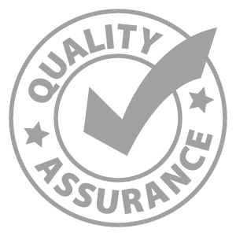

1. Introduction to Quality Assurance
What is testing?
Who does testing?
When to Start Testing and When to Stop Testing
Difference between Testing and Debugging
Testing Myths

Slide 5
What is Testing…?
Testing is the process of evaluating a system or its component(s) with the intent to find that whether it satisfies the specified requirements or not
Testing is executing a system in order to identify any gaps, errors or missing requirements in conflicting to the actual requirements

Slide 6

Who does Testing…?
Software Tester
Software Developer
Project Lead/Manager
End User

Slide 7
When to start Testing?
It is always better to start the application right from the beginning of SDLC rather than waiting for the testing phase.
Once test plan, test cases etc… are written and approved
Once the environment is ready
Once the build is given to QA team to test
Test data is ready.

Slide 8
When to stop Testing?
Completion of test case execution.
Completion of Functional and code coverage to a certain point.
Bug rate falls below a certain level and no high priority bugs are identified.
Management decision.

Slide 9
Difference between Testing and Debugging
Testing
It involves the identification of bug/error/defect in the software without correcting it..
Normally professionals with a Quality Assurance background are involved in the identification of bugs.
Debugging
It involves identifying, isolating and fixing the problems/bug. .
Developers who code the software conduct debugging upon encountering an error in the code.

Slide 10

Testing Myths…..!!
Testing cannot be started if the product is not fully developed
Testing ensures 100% Defect free product.
Missed defects are due to Testers.
Testers should be responsible for the quality of a product.
Test Automation should be used wherever it is possible to use it and to reduce time.
Automated testing is more powerful than manual testing
Any one can test a Software application
A tester’s task is only to find bugs

Slide 11


